Slide 1
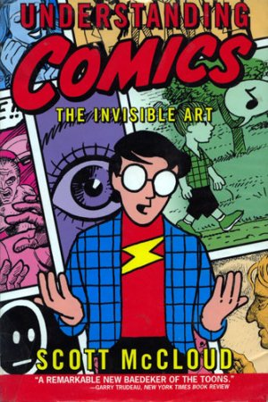
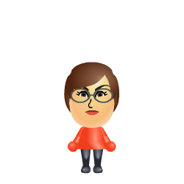
Mii and Mini Mii’s
Comic Book Adventure

Slide 2
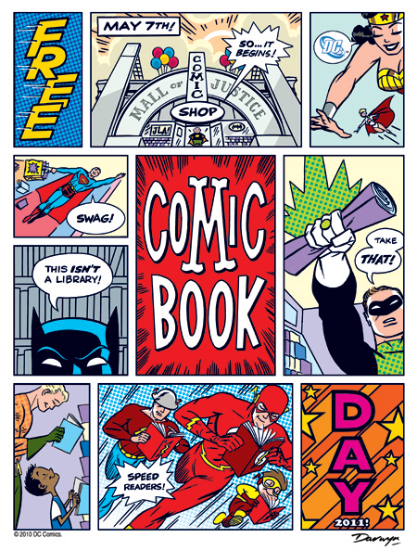
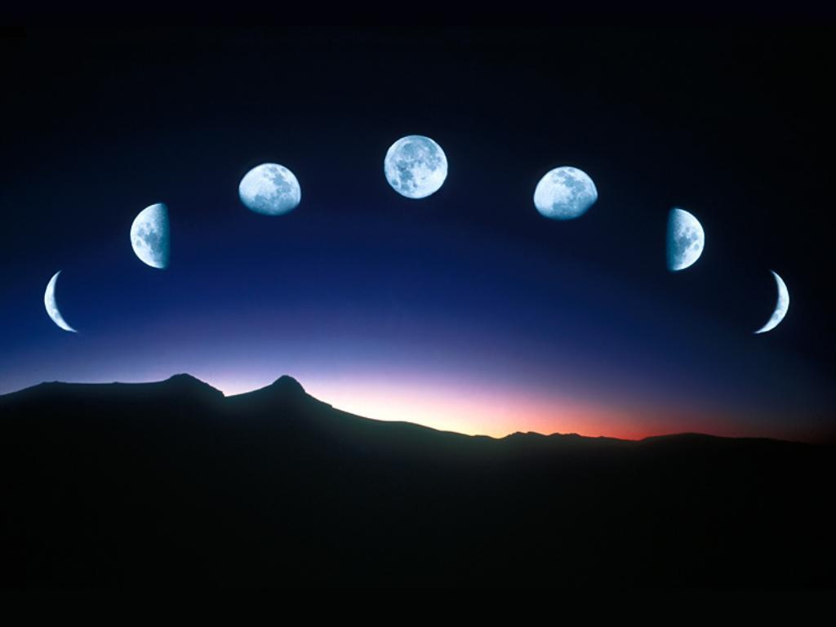
 | Decide where you want to go and what do want to do…
 | Add Action shapes…..
Insert you panels using a table
Where do we want to go?
Add backgrounds and you Miis…
BOOM!!
Pretty!

Slide 3
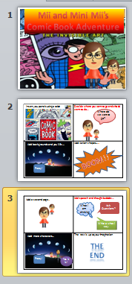
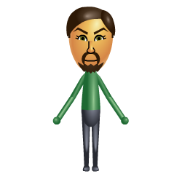
 | Add speech and thought bubbles…
 | The rest is up to your imagination..
Add a second page..
What I am thinking
Ask Questions?
Write a what I say.
Add more characters…
Don’t forget text boxes for transitions…
Pretty!
Yes it is!

Slide 4
The
End

