Slide 1
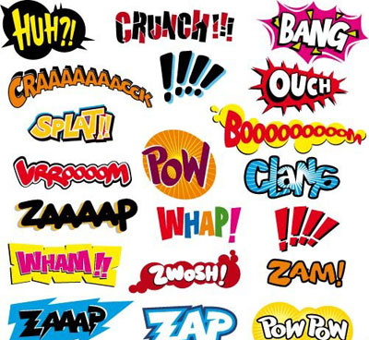
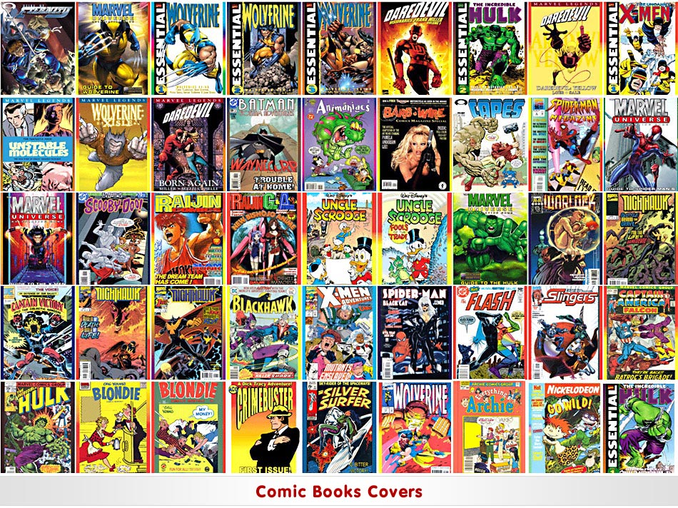
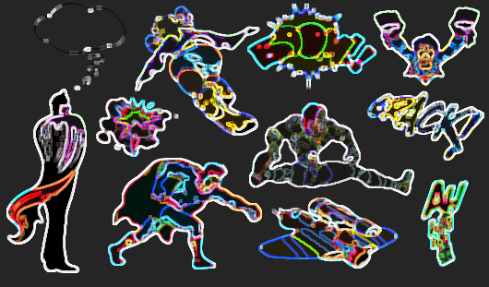
Creating a Comic Gift
By Ms. Schweitzer
© 2011

Slide 2
Once upon a time……
I decided to write a personalized comic book, so I had to find a place to make my characters. So I went shopping and found………..

Slide 3
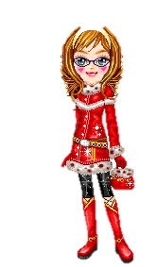
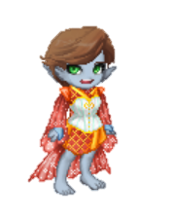
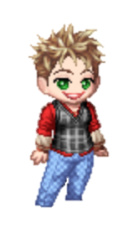
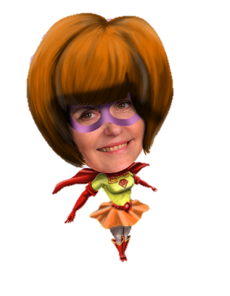
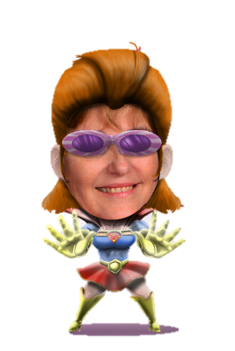
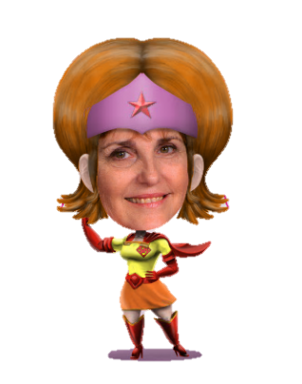
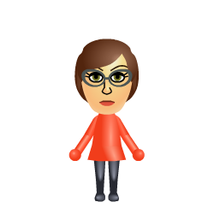
I was created at http://www.moeruavatar.com/index_en.shtml.
I was created at http://elouai.com/doll-makers/new-dollmaker.php
We were created at http://www.tektek.org
We were created at http://www.tektek.org
http://www.chibimachine.com
http://www.miisearch.com/mii-creator.html

Slide 4
Now that I have decide who….
Where will it happen? Gather some pictures for my comic book.
Who else will be involved? Create other characters.
What is going to happen? Write a small script.
Now Create your panels………..

Slide 5
Add shapes for panels….

Slide 6
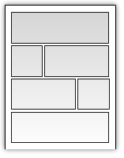
What will your panels look like ?

Slide 7
Add lines around the shapes..
Or add a background
Add Artistic Effects to fills..
Go to shape fill on the
Drawing Tool bar.
Fill if a picture.
Change to gradient fill…

Slide 8
Add the following:
The Characters
Speech balloon, word balloon, thought bubble
Caption lines like:
Once upon a time…..
Suddenly the lights when out….
When the lights came on…
Sound effects using WordArt and AutoShapes…
BAM! (pistol shot)
SPANG! (bullet hitting metal)
SPLAT! (bullet hitting masonry or concrete)
WANG! KAWUNNGG! (bullet hit with ricochet)
POW! (fist hitting chin)
SOK! (fist hitting chin)
CRAK! (nightstick hitting skull)
CRACK! (wrench hitting skull)
CREAK! (squeaky door opening)
EEEEEEEEEE! (scream)
CRASH! (furnishings being destroyed in a fight)

Slide 9
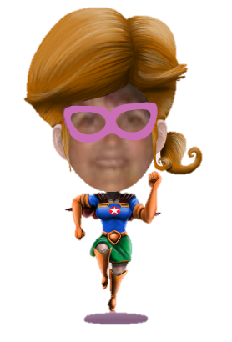
..Not as tall as grass. EEEE!
As energy waves leaves her hands….
Boom!
Thinking…
Faster than a rainbow
Run anywhere in the world… (pant, pant)
Zoom

Slide 10
Create a Cover

Slide 11
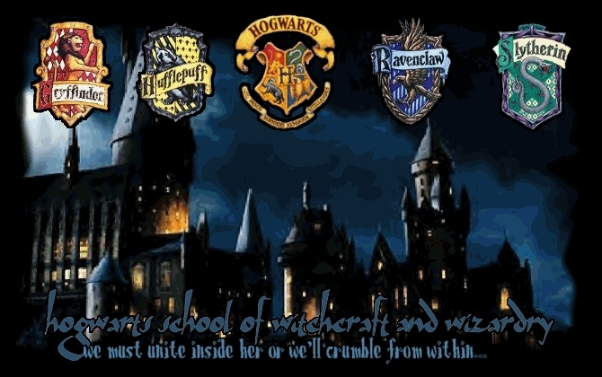
Me and Mini Me’s Adventure

Slide 12
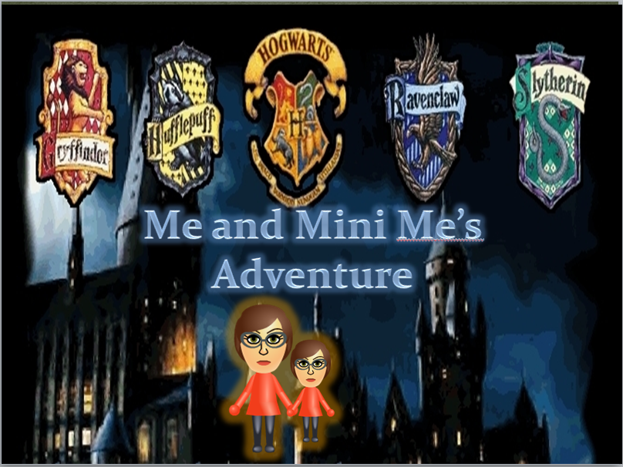
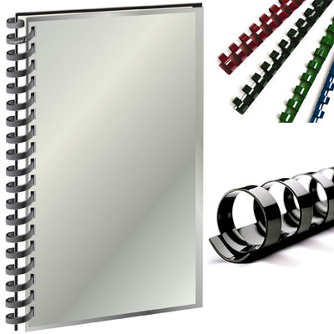
Print your book… and bind it…Give it!

